Slide 1
Module 4 Lecture
Dr. Patton

Slide 2
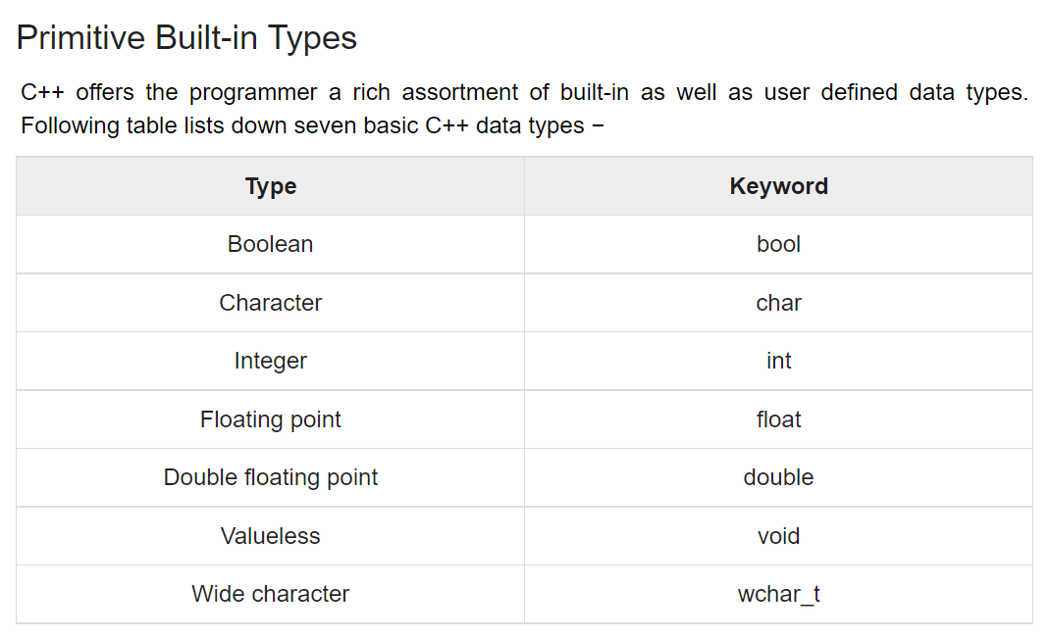
Variables
A variable is symbol or name that stands for a value.
For example, in the expression
z= x + y
z, x and y are variables.
Variables can represent numeric values, characters, character strings, or memory addresses.
Variables play an important role in computer programming because they enable programmers to write flexible programs. Rather than entering data directly into a program, a programmer can use variables to represent the data. Then, when the program is executed, the variables are replaced with real data. This makes it possible for the same program to process different sets of data.

Slide 3
The built-in data type for characters
char
How to define and initialize a char variable
char middle_initial = 'M';

Slide 4
A class that’s available from the string header
string
How to include the string header file
#include <string>
How to define and initialize a string variable
string message1 = "Invalid data entry";
string message2 = ""; // empty string

Slide 5
How to concatenate strings and chars
string first_name = "Bob"; // first_name is Bob
string last_name = "Smith"; // last_name is Smith
string name = last_name + ", " + first_name;
// name is Smith, Bob
name = first_name + ' ' + middle_initial + ' ' + last_name;
// name is Bob M Smith
How to append one string to another with the += operator
name = first_name + ' '; // name is Bob followed by a space
name += last_name; // name is Bob Smith

Slide 6
Escape sequences for special characters
Sequence Character
\n Newline
\t Tab
\r Return
\" Quotation mark
\\ Backslash

Slide 7
A string that uses a newline character
"Code: CPP\nPrice: $49.50"
Result
Code: CPP
Price: $49.50

Slide 8
A string that uses tabs
"Joe\tSmith\nKate\tLewis"
Result
Joe Smith
Kate Lewis

Slide 9
A string that uses double quotes
"Type \"x\" to exit"
Result
Type "x" to exit

Slide 10
A string that uses backslashes
"C:\\murach\\cpp\\files"
Result
C:\murach\cpp\files

Slide 11
Char examples
char newline = '\n';
char tab = '\t';
char sep = '\\'; // use backslash as a separator

Slide 12
The code for the Guest Book program (part 1)
#include <iostream>
#include <string>
using namespace std;
int main()
{
cout << "Guest Book\n\n";
string first_name;
cout << "First name:\t";
cin >> first_name; // get first string only
cin.ignore(100, '\n'); // discard leftover chars
// and newline
char middle_initial;
cout << "Middle initial:\t";
middle_initial = cin.get(); // get first char only
cin.ignore(100, '\n'); // discard leftover chars
// and newline

Slide 13
The code for the Guest Book program (part 2)
string last_name;
cout << "Last name:\t";
getline(cin, last_name); // get entire line
string city;
cout << "City:\t\t";
getline(cin, city); // get entire line
string country;
cout << "Country:\t";
getline(cin, country); // get entire line
cout << "\nENTRY\n" // display the entry
<< first_name + ' ' + middle_initial + ". " +
last_name + '\n'
<< city + ", " + country + "\n\n";
}

Slide 14
Debugging tips
For a runtime error, go to the line in the source code that was running when the program crashed. In most IDEs, you can do that by clicking on the link to the line of source code. That should give you a strong indication of what caused the error.
For a logical error, first figure out how the source code produced that output. Then, fix the code and test the program again.

Slide 15
How to make decisions

Slide 16
Relational operators
Operator Name
== Equality
!= Inequality
> Greater Than
< Less Than
>= Greater Than Or Equal
<= Less Than Or Equal

Slide 17
Examples of Boolean expressions
counter == 5 // equal to a numeric literal
test_score != 0 // not equal to a numeric // literal
years > 0 // greater than a numeric // literal
i < months // less than a numeric variable
subtotal >= 9.99 // greater than or equal to // a numeric literal
quantity <= reorder_amt // less than or equal to // a numeric variable

Slide 18
How to test strings and chars for equality
choice == 'y' // char equal to a char literal
name == "Jones" // string equal to a string literal
name != name2 // string not equal to another // string variable

Slide 19
Two functions that convert the case of a char
tolower(char)
toupper(char)
A case-insensitive test of two chars for equality
tolower(choice) == 'y' // true if choice is 'y' or 'Y'

Slide 20
The syntax of the if statement
if (boolean_expression) { statements }
[else if (boolean_expression) { statements }] ...
[else { statements }]
An if statement with only an if clause
double discount_percent = .05;
if (subtotal >= 100) {
discount_percent = .1;
}
An if statement with an else clause
double discount_percent;
if (subtotal >= 100) {
discount_percent = .1;
} else {
discount_percent = .05;
}

Slide 21
An if statement with multiple else if clauses
double discount_percent;
if (subtotal >= 300) {
discount_percent = .3;
} else if (subtotal >= 200) {
discount_percent = .2;
} else if (subtotal >= 100) {
discount_percent = .1;
} else {
discount_percent = .05;
}

Slide 22
An if statement without braces
double discount_percent;
if (subtotal >= 100)
discount_percent = .1;
else
discount_percent = .05;

Slide 23
An if statement without braces that causes an error
double discount_percent = .05;
string shipping_method = "USPS";
if (subtotal >= 100)
discount_percent = .1;
shipping_method = "FedEx"; // Error! This statement
// is always executed
An if statement that uses braces to fix the error
double discount_percent = .05;
string shipping_method = "USPS";
if (subtotal >= 100) {
discount_percent = .1;
shipping_method = "FedEx"; // Braces fix error
}

Slide 24
Clauses that contain multiple statements
double discount_percent;
string shipping_method;
if (subtotal >= 100) {
discount_percent = .1;
shipping_method = "FedEx";
} else {
discount_percent = .05;
shipping_method = "USPS";
}

Slide 25
Another coding style for brace placement
double discount_percent;
string shipping_method;
if (subtotal >= 100)
{
discount_percent = .1;
shipping_method = "FedEx";
}
else
{
discount_percent = .05;
shipping_method = "USPS";
}

Slide 26
The console for the Invoice 1.0 program
Invoice Total Calculator 1.0
Enter a subtotal: 129.43
Discount percent: 0.1
Discount amount: 12.94
Invoice total: 116.49
Bye!

Slide 27
Logical operators
Operator Name
&& AND
|| OR
! NOT
Order of precedence
NOT operator
AND operator
OR operator

Slide 28
Boolean expressions that use logical operators
// The AND operator
age >= 65 && city == "Chicago"
// The OR operator
city == "Greenville" || age >= 65
// The NOT operator
!(age >= 65)
// Two AND operators
age >= 65 && city == "Greenville" && state == "SC"
// Two OR operators
age >= 65 || age <= 18 || status == "retired"
// AND and OR operators with parens to clarify sequence
// of operations
(age >= 65 && status == "retired") || age < 18
// AND and OR operators with parens to change sequence
// of operations
age >= 65 && (status == "retired" || state == "SC")

Slide 29
An if statement that uses logical operators
double discount_percent;
if (subtotal >= 100 && subtotal < 200) {
discount_percent = .1;
} else if (subtotal >= 200 && subtotal < 300) {
discount_percent = .2;
} else if (subtotal >= 300) {
discount_percent = .3;
} else {
discount_percent = .05;
}

Slide 30
An if statement that validates the range of a score
if (score >= 0 && score <= 100) {
cout << "Thanks for entering a test score.\n";
} else {
cout << "Test score must be from 0 - 100.\n";
}
An if statement that validates the customer type
if (customer_type != 'r' && customer_type != 'w') {
cout << "Customer type must be 'r' or 'w'.\n";
}

Slide 31
A table that summarizes the discount rules
Customer type Invoice subtotal Discount percent
r (retail) < 100 .0
>= 100 and < 250 .1
>= 250 .2
w (wholesale) < 500 .4
>= 500 .5

Slide 32
Nested if statements for customer discounts
double discount_percent = .0;
if (tolower(customer_type) == 'r') {
if (subtotal < 100) { // begin nested if
discount_percent = .0;
} else if (subtotal >= 100 && subtotal < 250) {
discount_percent = .1;
} else {
discount_percent = .2;
} // end nested if
} else if (tolower(customer_type) == 'w') {
if (subtotal < 500) { // begin nested if
discount_percent = .4;
} else {
discount_percent = .5;
} // end nested if
}

Slide 33
An if statement that gets the same results
double discount_percent = .0;
// the discounts for retail customers
if (tolower(customer_type) == 'r' && subtotal < 100) {
discount_percent = .0;
} else if (tolower(customer_type) == 'r' &&
(subtotal >= 100 && subtotal < 250)) {
discount_percent = .1;
} else if (tolower(customer_type) == 'r' &&
subtotal >= 250) {
discount_percent = .2;
// the discounts for wholesale customers
} else if (tolower(customer_type) == 'w' &&
subtotal < 500) {
discount_percent = .4;
} else if (tolower(customer_type) == 'w' &&
subtotal >= 500) {
discount_percent = .5;
}

Slide 34
The console for the Invoice 2.0 program
The Invoice Total Calculator 2.0
Enter customer type (r/w): r
Enter subtotal: 125.75
Discount percent: 0.1
Discount amount: 12.58
Invoice total: 113.17
Bye!

Slide 35
The code for the Invoice 2.0 program (part 1)
#include <iostream>
#include <cmath>
using namespace std;
int main() {
// display title
cout << "The Invoice Total Calculator 2.0\n\n";
// get input
char customer_type;
cout << "Enter customer type (r/w): ";
cin >> customer_type;
double subtotal;
cout << "Enter subtotal: ";
cin >> subtotal;

Slide 36
The code for the Invoice 2.0 program (part 2)
// set discount percent
double discount_percent;
if (tolower(customer_type) == 'r') { // RETAIL
if (subtotal < 100) {
discount_percent = .0;
}
else if (subtotal >= 100 && subtotal < 250) {
discount_percent = .1;
}
else {
discount_percent = .2;
}
}
else if (tolower(customer_type) == 'w') { // WHOLESALE
if (subtotal < 500) {
discount_percent = .4;
}
else {
discount_percent = .5;
}
}
else { // OTHER
discount_percent = .0;
}

Slide 37
The code for the Invoice 2.0 program (part 3)
// calculate and round results
double discount_amount = subtotal * discount_percent;
discount_amount = round(discount_amount * 100) / 100;
double invoice_total = subtotal - discount_amount;
invoice_total = round(invoice_total * 100) / 100;
// display output
cout << "Discount percent: "
<< discount_percent << endl
<< "Discount amount: "
<< discount_amount << endl
<< "Invoice total: "
<< invoice_total << endl << endl;
cout << "Bye!\n\n";
}

Slide 38
The syntax for a conditional expression
boolean_expression ? if_true : if_false
A conditional expression
subtotal >= 100 ? .1 : .05 // returns .1 or .05
// depending on subtotal
How to use a conditional operator to set the value of a variable
double discount_percent = subtotal >= 100 ? .1 : .05;

Slide 39
A statement that uses parentheses to identify the Boolean expression
double discount_percent = (subtotal >= 100) ? .1 : .05;
An if statement that performs the same task
double discount_percent;
if (subtotal >= 100)
discount_percent = .1;
else
discount_percent = .05;

Slide 40
The syntax of the switch statement
switch (switch_expression) {
case label1:
statements
break;
[case label2:
statements
break;] ...
[default:
statements
break;]
}

Slide 41
A switch statement that uses an int variable
string product_description;
switch (product_id) {
case 1:
product_description = "Hammer";
break;
case 2:
product_description = "Box of Nails";
break;
default:
product_description = "No product found for specified ID";
break;
}

Slide 42
A switch statement that falls through case labels
string day;
switch (day_of_week) {
case 1:
case 2:
case 3:
case 4:
case 5:
day = "weekday";
break;
case 6:
case 7:
day = "weekend";
break;
}

Slide 43
A switch statement for a menu system (part 1)
// display menu
cout << "1. List all movies" << endl
<< "2. Add a movie" << endl
<< "3. Exit" << endl << endl;
// get menu item from user
cout << "Menu item: ";
int menu_item;
cin >> menu_item;

Slide 44
A switch statement for a menu system (part 2)
// execute the correct code for the menu item
switch (menu_item) {
case 1:
cout << "MOVIE LIST" << endl;
// code that lists all movies goes here
break;
case 2:
cout << "ADD A MOVIE" << endl;
// code that adds a movie goes here
break;
case 3:
cout << "Bye!";
break;
default:
cout << "Invalid menu item! Try again." << endl;
break;
}

Slide 45
A switch statement for the Invoice app (part 1)
double discount_percent;
switch (customer_type) {
// RETAIL
case 'r':
case 'R':
if (subtotal < 100)
discount_percent = .0;
else if (subtotal >= 100 && subtotal < 250)
discount_percent = .1;
else
discount_percent = .2;
break;

Slide 46
A switch statement for the Invoice app (part 2)
// WHOLESALE
case 'w':
case 'W':
if (subtotal < 500)
discount_percent = .4;
else
discount_percent = .5;
break;
// OTHER
default:
discount_percent = .0;
break;
}

Slide 47
Questions?

